Slide 1
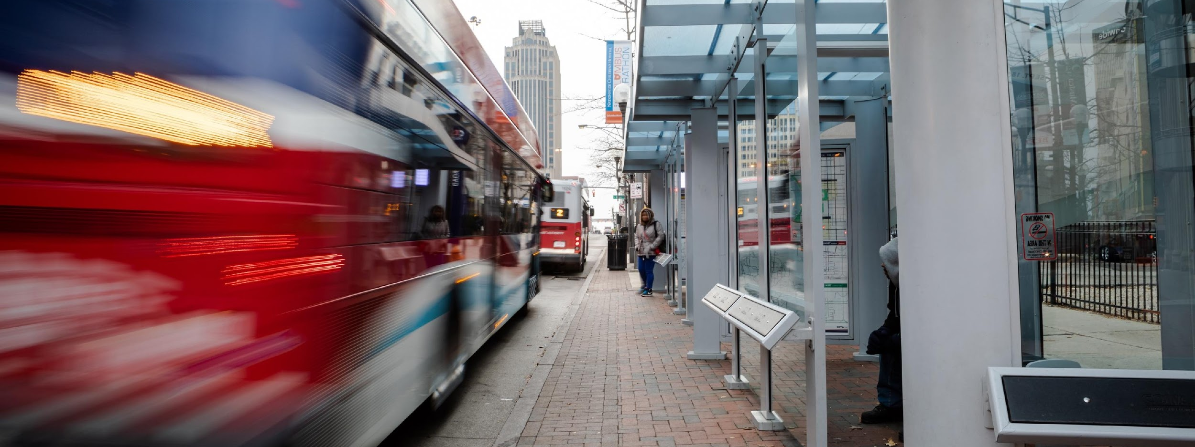

PUBLIC TRANSIT AND THE FIRST/LAST MILE CHALLENGE
SuccessBound Conference 2020
The City of Grove City &
Central Ohio Transit Authority (COTA) Partnership

Slide 2
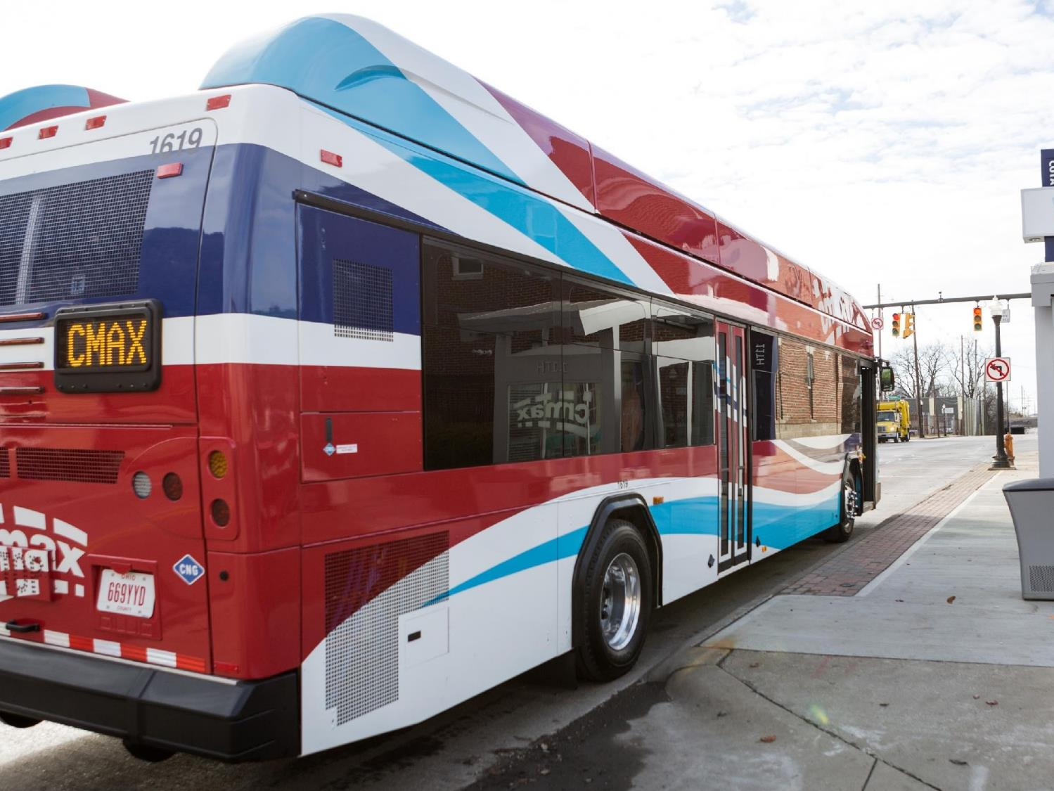
OUR VISION
MOVE
TO
EVERY LIFE FORWARD

Slide 3
OUR MISSION
WE PROVIDE SOLUTIONS
that connect people to
PROSPERITY
THROUGH INNOVATION, DEDICATION AND TEAMWORK

Slide 4
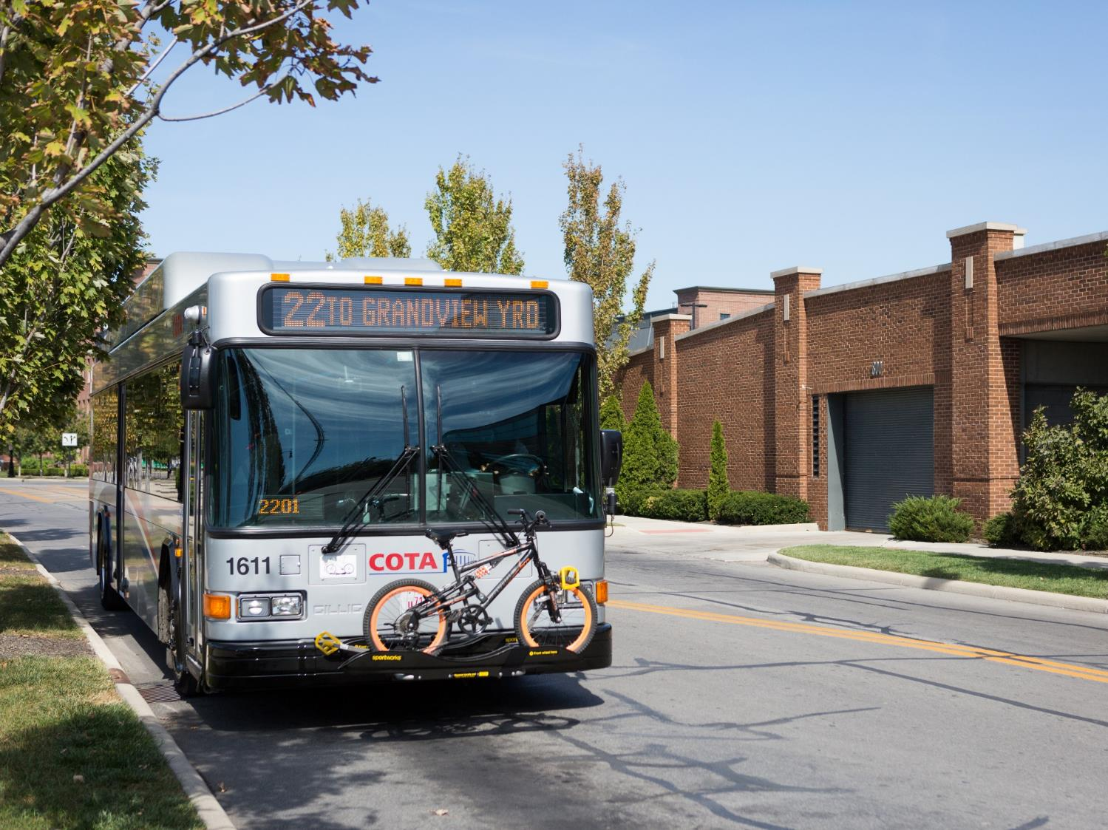
ABOUT COTA
First Passenger Trips in 1974
$170 million operating budget for 2020
Operational Funding – Total of 0.5% sales tax
  - Permanent 0.25% sales tax
  - 10-year renewable 0.25% sales tax
Pursue major federal funding for capital projects
1,150+ employees, more than 700 operators
327 buses, among the youngest in the industry
Approx. 19 million trips annually (60,000 daily trips)
Mainstream, serves seniors and people with disabilities with 250,000+ trips each year
Fixed-Route
Mainstream
COTA Plus

Slide 5
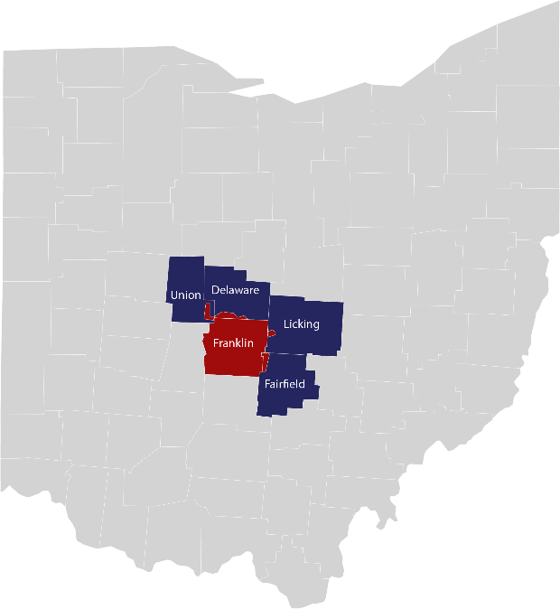
OPERATIONS & GOVERNANCE
Service Area
  562 square miles
  1.2 million residents
  All of Franklin County
  Portions of Delaware, Fairfield, Licking, and Union Counties (within charter cities)
Governed by 13-member Board of Trustees
  7 members appointed by City of Columbus
  2 members appointed by Franklin County
  4 members appointed by other municipalities (rotating)
  2 Community Advisory Panels

Slide 6
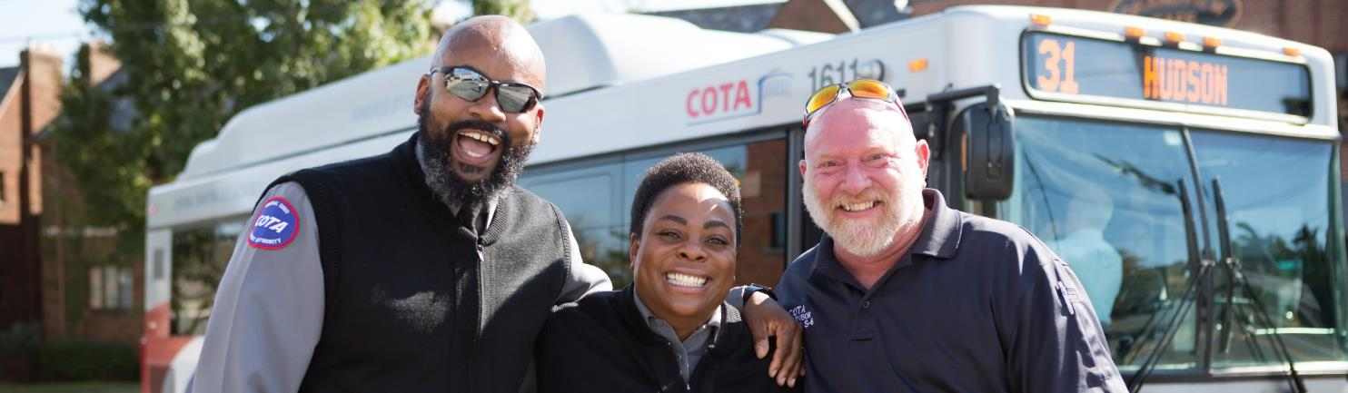
COMMITMENT TO CUSTOMER EXPERIENCE
91%
93%
3%
OVERALL SATISFACTION
COURTESY OF BUS OPERATORS
RIDERSHIP
IN 2018
94%
1 of 6
OF CUSTOMERS SAY THEY ARE LIKELY TO RECOMMEND COTA SERVICES IN THE FUTURE
MAJOR METROPOLITAN AREAS THAT DID NOT LOSE RIDERSHIP
LAST YEAR

Slide 7



PROBLEM FROM AN EMPLOYER’S PERSPECTIVE
Recruiting and retaining a dependable workforce

Slide 8


PROBLEM FROM AN EMPLOYEE’S PERSPECTIVE
Efficient and reliable transportation to and from work, especially sites that are not adjacent to a COTA bus line

Slide 9
COST OF THE PROBLEM
600 workers
30% turnover rate
$5,000 cost
$900,000 annual turnover cost

Slide 10

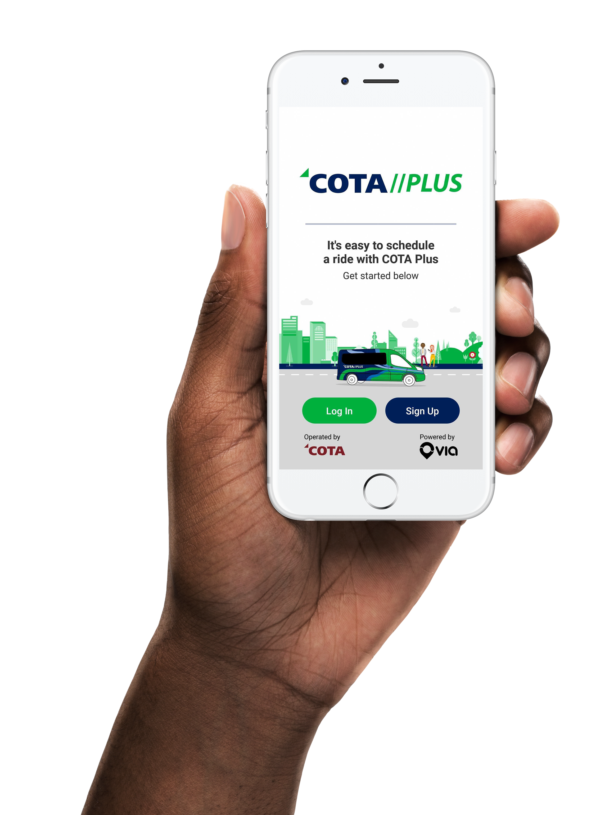
COTA-operated, real-time, on-demand
Smaller passenger vehicles
Riders must register through the COTA Plus app or by calling COTA Customer Support
Trips are requested via the COTA Plus app or by calling COTA Customer Support
Service is available within a defined geographic zone
Trips may be shared with other riders
Wait times less than 15 minutes
Riders may be directed to nearby pick-up locations

Slide 11
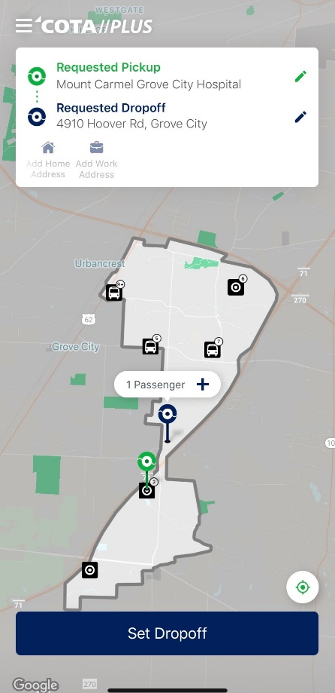
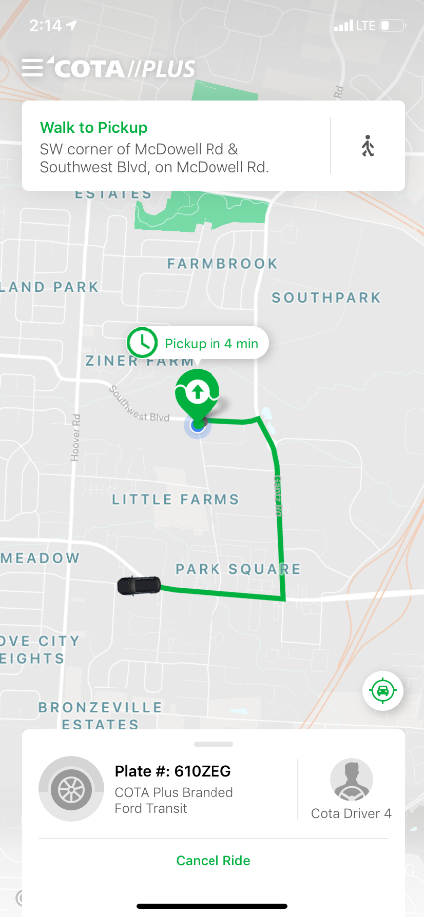
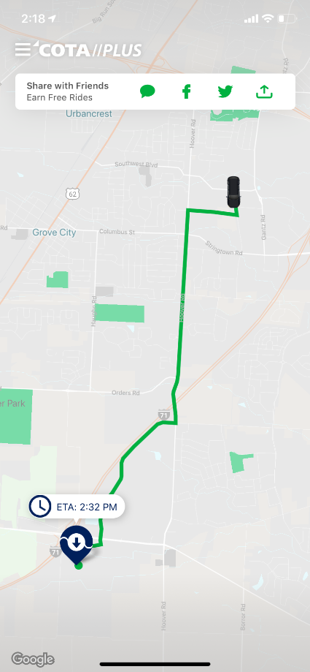


Home Screen
Awaiting Vehicle
In Transit

Slide 12
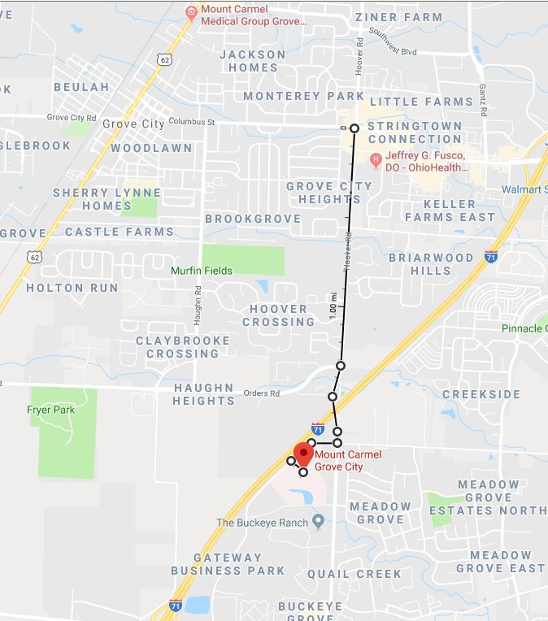
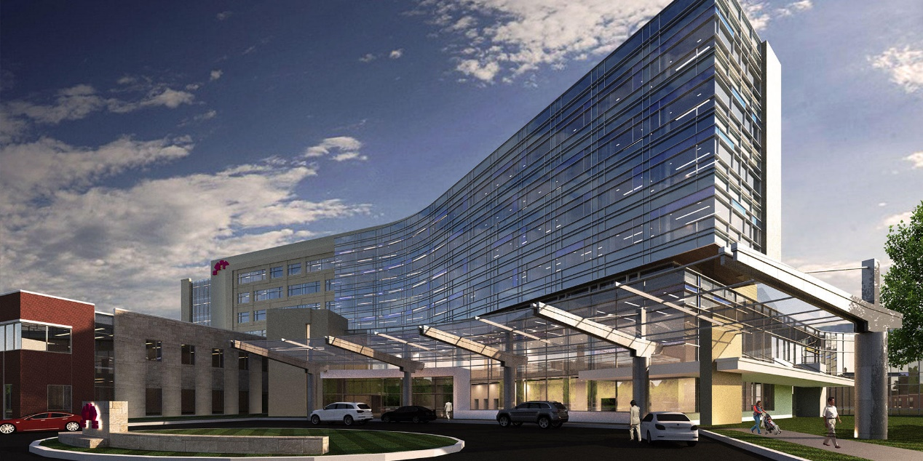
OPPORTUNITY KNOCKS
Mount Carmel Grove City Hospital
Approx. 2.1 miles between nearest COTA stop & Mount Carmel Grove City Hospital

Slide 13
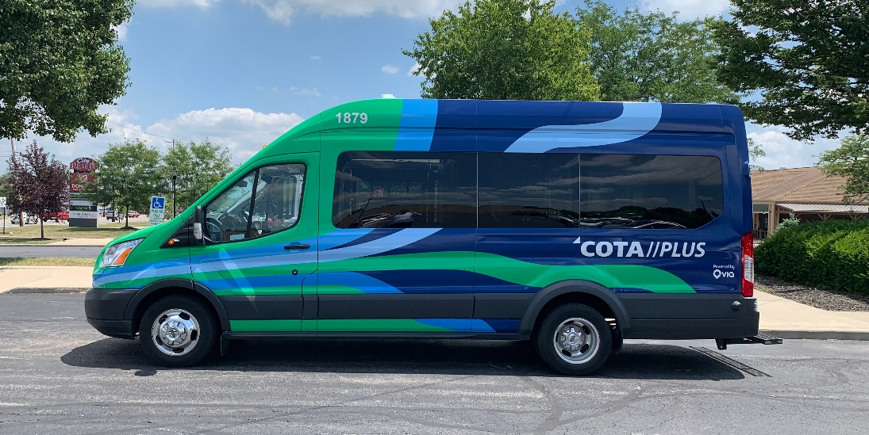
GROVE CITY ON-DEMAND TRANSPORTATION
Initial 1-year pilot
July 2019 – July 2020
Connections with...
Line 3 (all-day service every 30 mins.)
Line 61 (Rush Hour service only)
Monday – Friday
5:30 AM – 8:00 PM (14.5 hours/day)
Funding partnerships with the City of Grove City, the Mid-Ohio Regional Planning Commission (MORPC), and COTA

Slide 14
GROVE CITY ON-DEMAND TRANSPORTATION
  Fare structure
    Base Fare (one-way trip) $3.00/ride
    1-Day Pass $6.00/day
    5-Day Pass $20.00/week
    Connections to/from bus stop No Fare
    C-pass No Fare
    Students No Fare
    Discounts available for seniors (65+), riders with disabilities, Medicare card holders, and other qualified riders
  Benefits of using COTA Plus
        Less than 15-minute wait time
        Curb or corner pick-up
        Trained Customer Service Representatives
        Guaranteed response/service
        Focus on safety and rider satisfaction
        Affordable

Slide 15
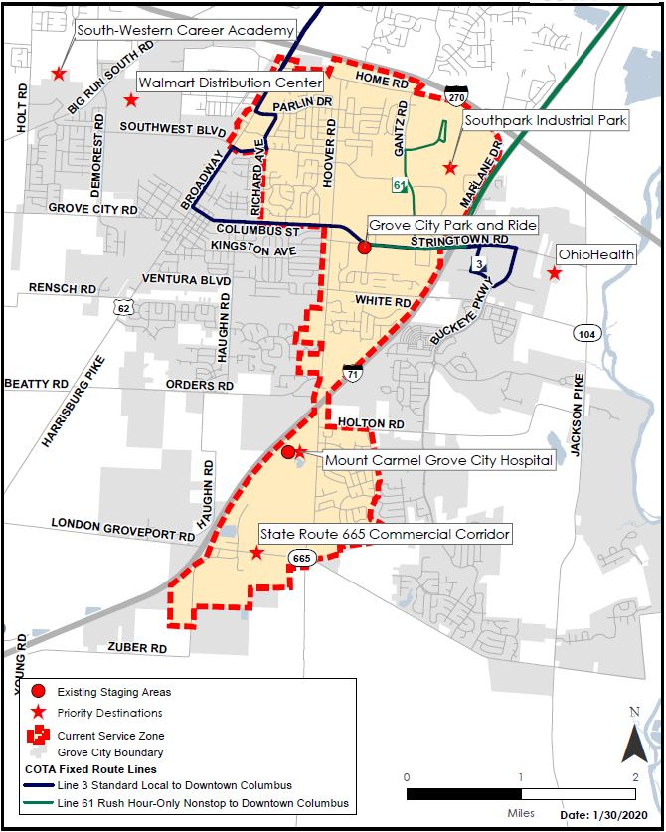
ORIGINAL
ZONE OF SERVICE
  COTA Grove City Park and Ride
  Mount Carmel Grove City Hospital
  Mid-Ohio Foodbank
  FedEx
  Toppan Merrill
  HKT Teleservices
  Communications Test Design, Inc. (CTDI)
  Tigerpoly Manufacturing, Inc.
  Select residential neighborhoods

Slide 16
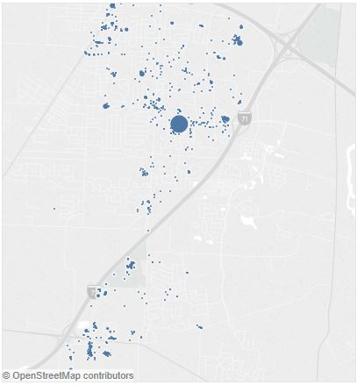
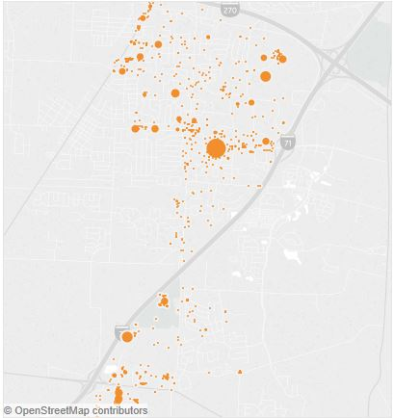
REQUESTED ORIGINS
REQUESTED DESTINATIONS
Southpark
Industrial Park
Southpark
Industrial Park
COTA Park & Ride
COTA Park & Ride
Mount Carmel Grove City
Hospital
Mount Carmel Grove City
Hospital
Businesses
Near SR 665
Businesses
Near SR 665

Slide 17

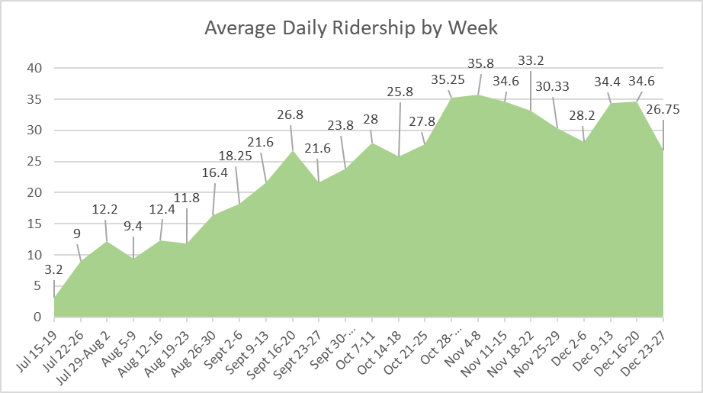
Total number of completed rides 3,356
Total number of accounts 903
Avg. Pick-up ETA 7.1 Minutes
Avg. Ride Duration 7.8 Minutes
Avg. Trip Distance 1.9 miles
Avg. Star Rating 4.8/5 stars
Data as of January 30, 2020
Avg. Daily Ridership by Week

Slide 18
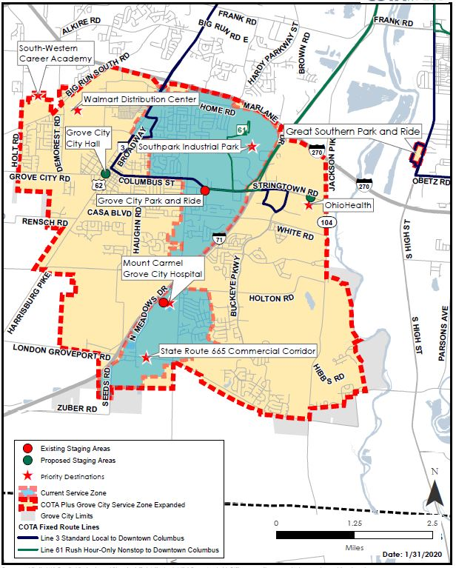
EXPANDED
ZONE OF SERVICE
(Monday, April 6, 2020)
NEW DESTINATIONS
Downtown Grove City
Additional Residents
Senior Centers
South-Western Career Academy
Additional Employers
Additional Retail Options

Slide 19
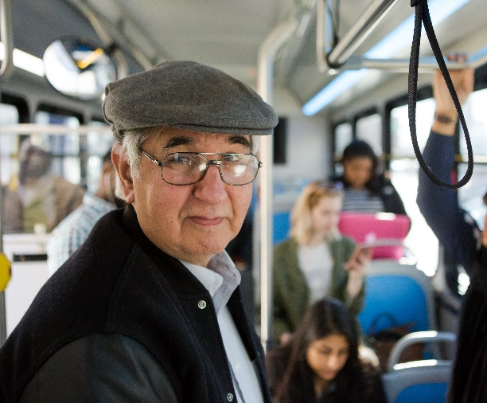
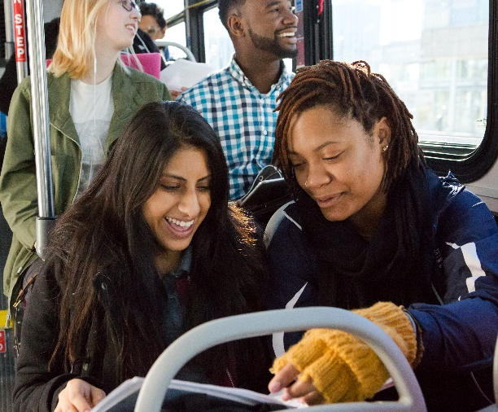
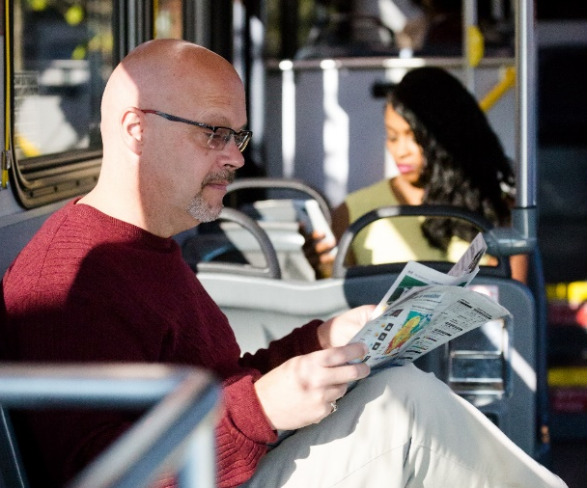
SERVICE ATTRIBUTES
  Hours (5:30 am – 8:00 pm)
  Trained Customer Service Representatives available to assist residents establish an account and request a ride
  On-demand access, no need to pre-schedule
  Guaranteed response/service
  Focus on safety and rider satisfaction
  Affordable
IMPROVED ACCESS TO
  Jobs
  Healthcare
  School/internships
  Quality of life activities

Slide 20


FOLLOW
COTA.com
Michael J. Loges Dan Havener
Senior Economic Development Project Manager Economic Development Manager
COTA City of Grove City, Ohio
O: 614.308.4380 O: 614.277.3014
E: LogesMJ@cota.com E: Dhavener@grovecityohio.gov

